Slide 1


Wooden structures in Italy
Wooden structures in Italy
Prof. Ing. Giuseppe Donato
Prof- Arch Vincenzo Carito
Jobshadowing at MANRESA
10/02/2025 -14/02/2025
Institute Guillem Catà- Spain
VET 2024-1-IT02-KA121-VET-000213359

Slide 2
Wooden structures in Italy
Lightweight: Wood is a lightweight material compared to other building materials, making it easier to transport and install.
Resistance: Laminated and solid wood offers high structural resistance.
Insulation: Wood has excellent insulating properties, helping to reduce energy costs.
Versatility: Wood adapts to different architectural shapes and designs.

Slide 3
Wooden structures in Italy
Advantages
  Sustainability: Wood is a renewable resource and its use reduces environmental impact.
  Construction speed: Wooden structures can be prefabricated and assembled quickly.
  Living comfort: Wood creates a warm and welcoming environment, regulating humidity and temperature.
  Seismic resistance: Wooden structures are light and flexible, offering good resistance to earthquakes.

Slide 4
Wooden structures in Italy
Disadvantages
  Initial cost: The initial cost of wooden structures can be higher than other materials.
  Maintenance: Wood requires periodic maintenance to protect it from atmospheric agents and parasites.
  Fire resistance: Wood is flammable, but can be treated to increase its fire resistance.
  Humidity: Wood may be subject to dimensional variations based on humidity.

Slide 5
Wooden structures in Italy
Maintenance. Maintenance of wooden structures is essential to ensure their durability over time. Key interventions include:
  Periodic checks of the conditions of the wood and finishes.
  Protective treatment against fungi, insects and atmospheric agents.
  Painting or impregnating to protect the wood from humidity.
  Repair or replacement of damaged items.

Slide 6
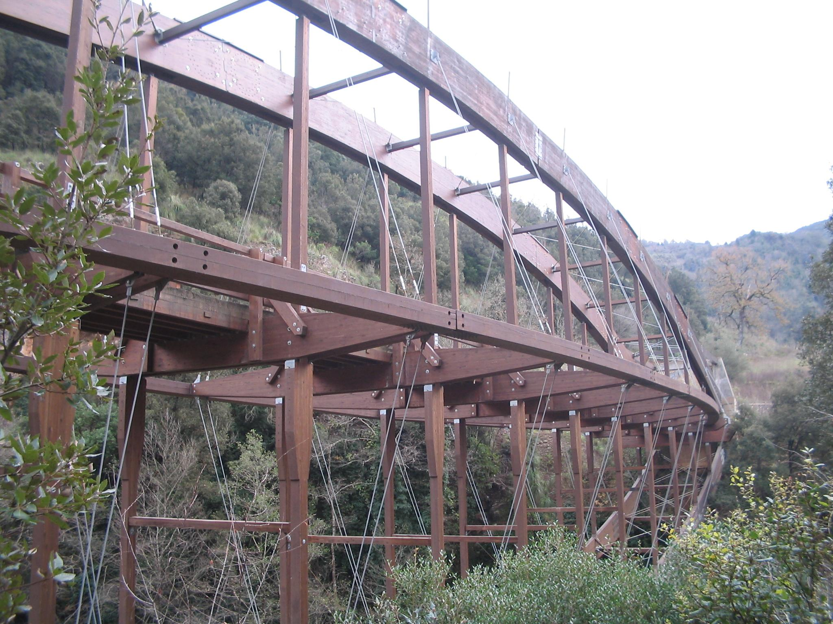
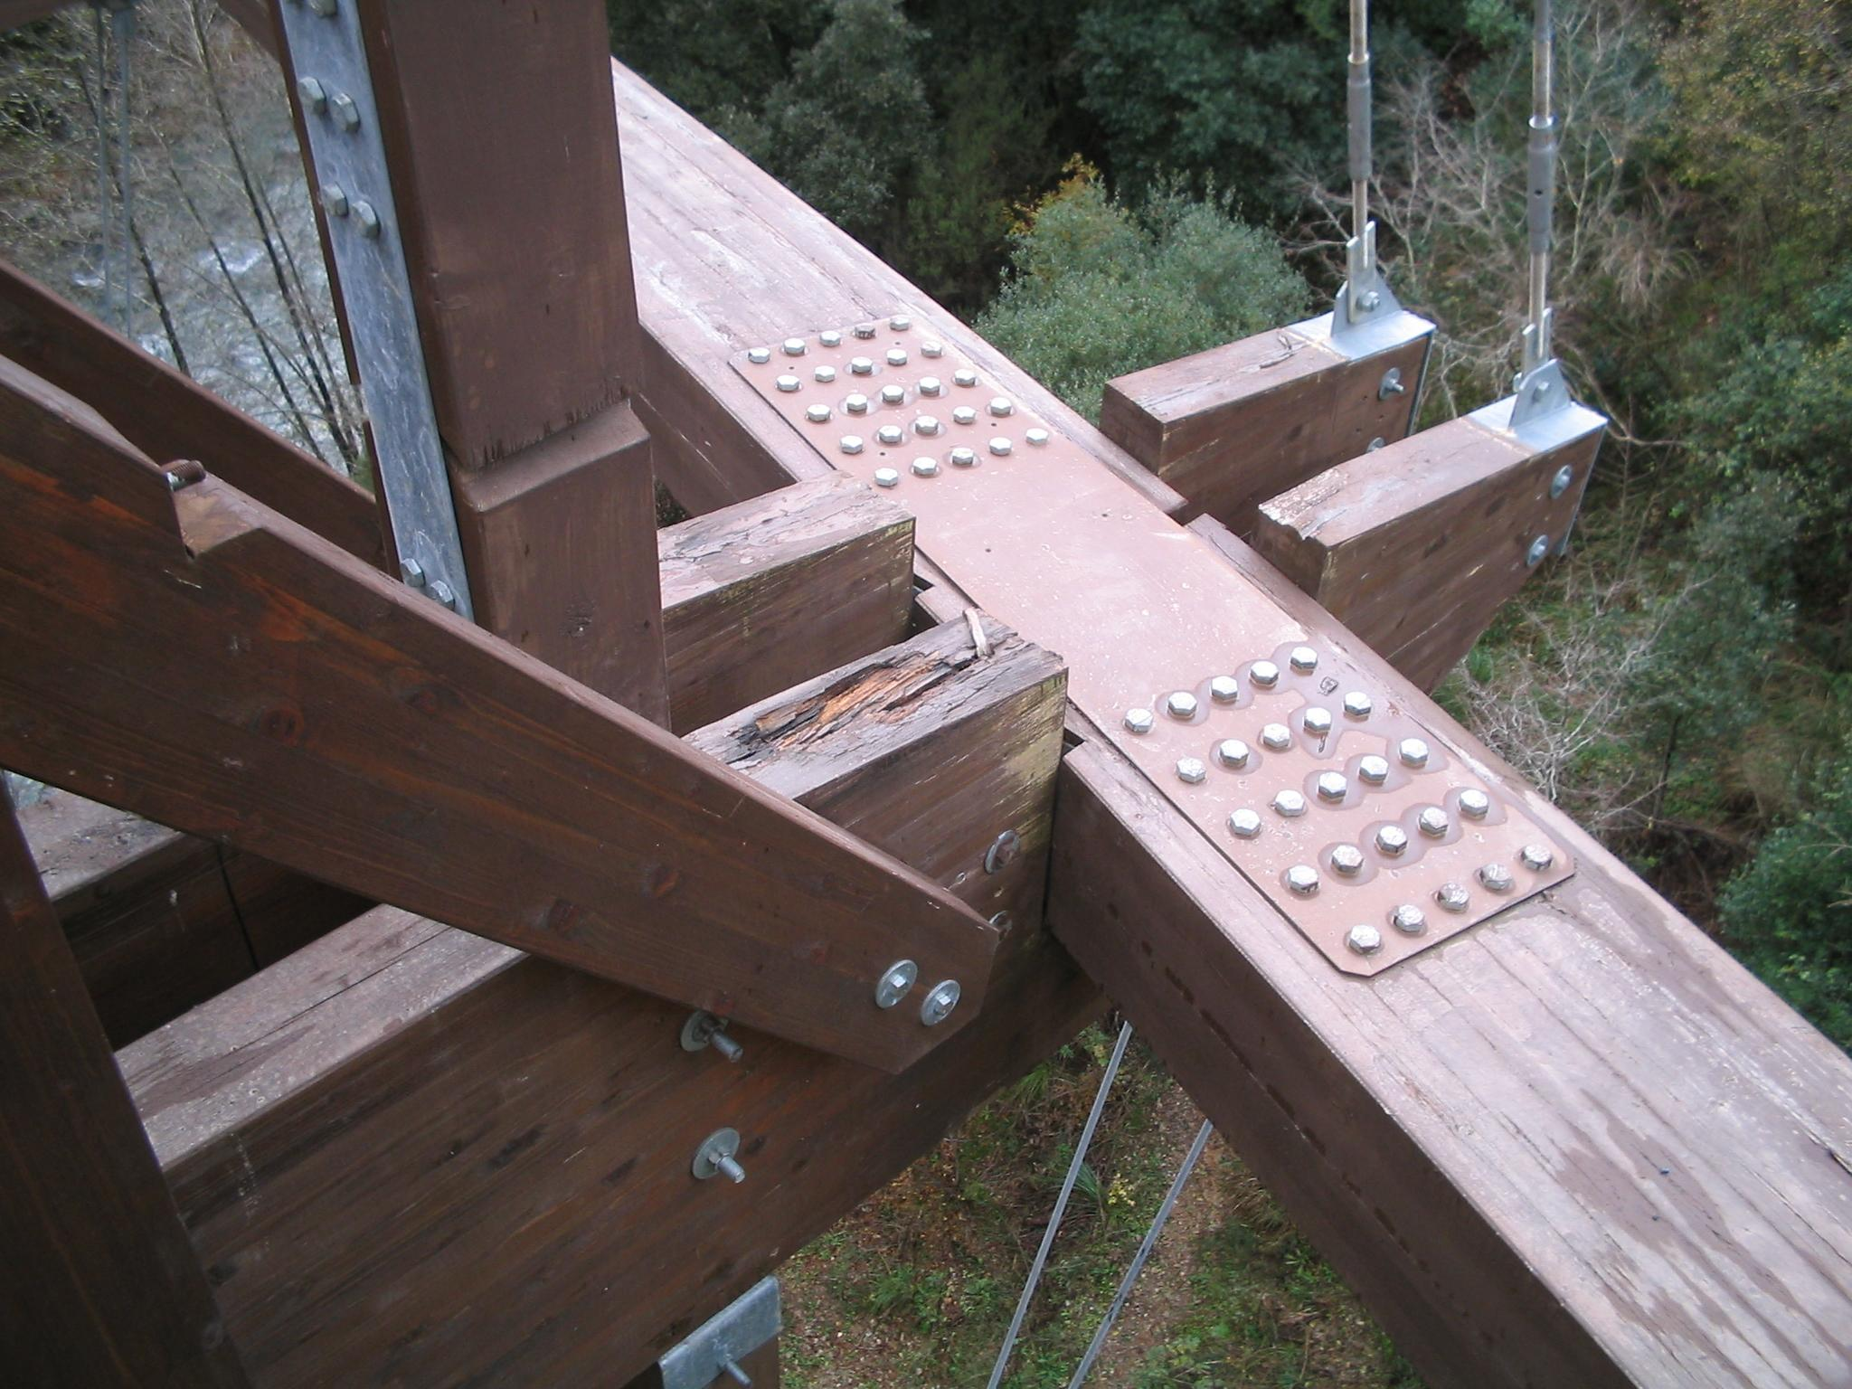
Wooden structures in Italy
Maintenance.
Bridge - LAO river
Calabria 2000
Degradation

Slide 7
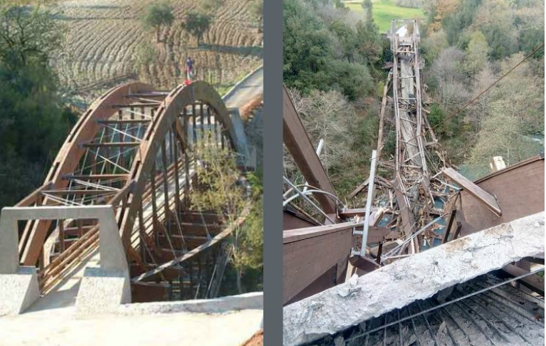
Wooden structures in Italy
Maintenance 2000 - 2017

Slide 8
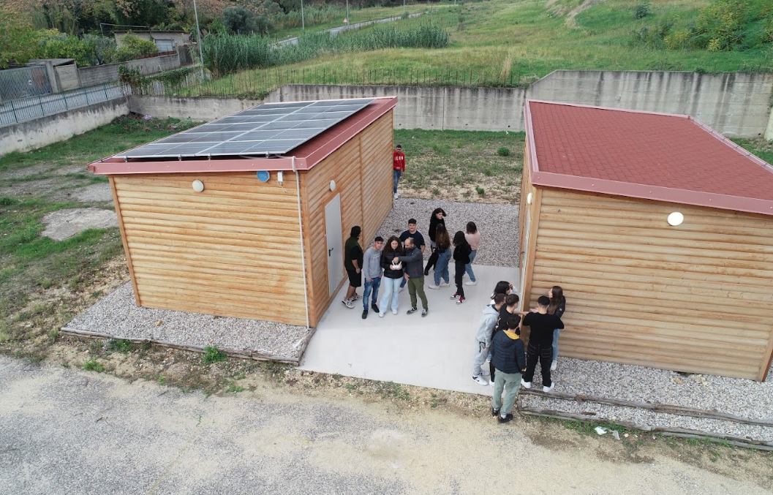
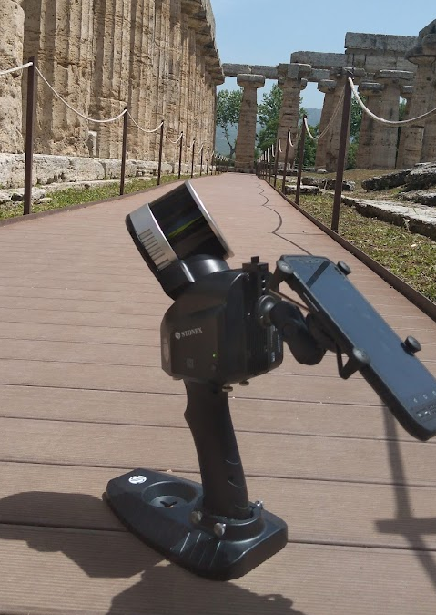
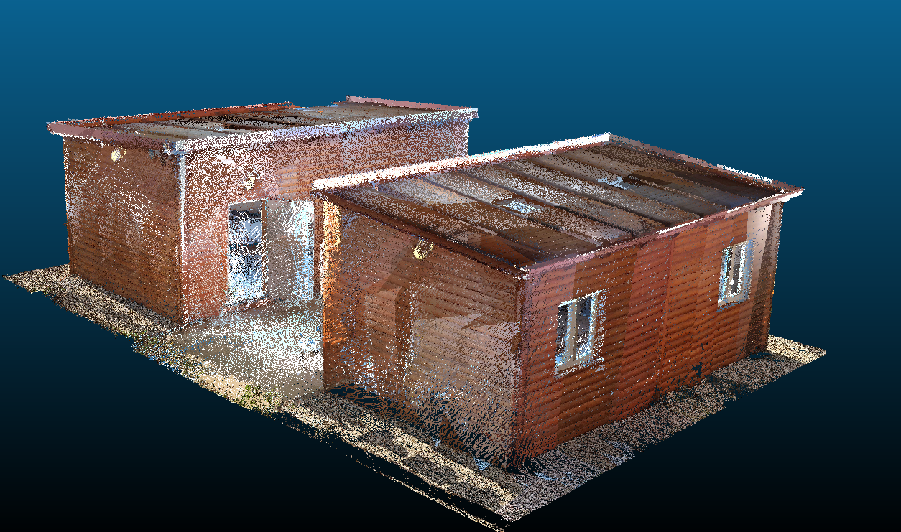
Wooden structures in Italy
References to the main technical regulations on wooden constructions, such as the NTC 2018 and the UNI EN standards. Importance of certification and compliance with safety and quality requirements.
Case study. “casette” at ITT MALAFARINA SOVERATO.
New gym under construction at ITT MALAFARINA SOVERATO.
Point Cloud

Slide 9
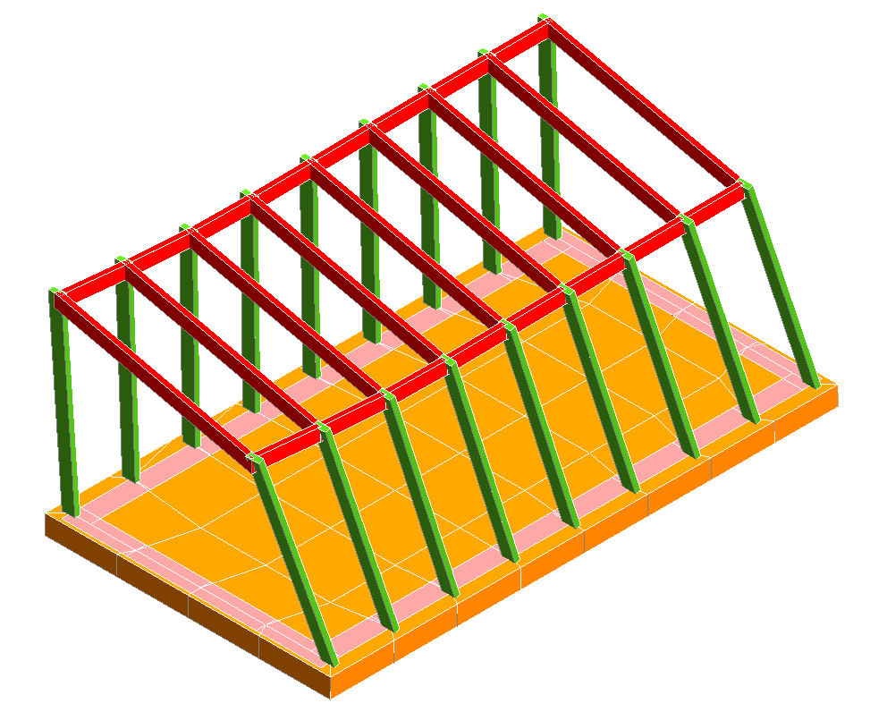
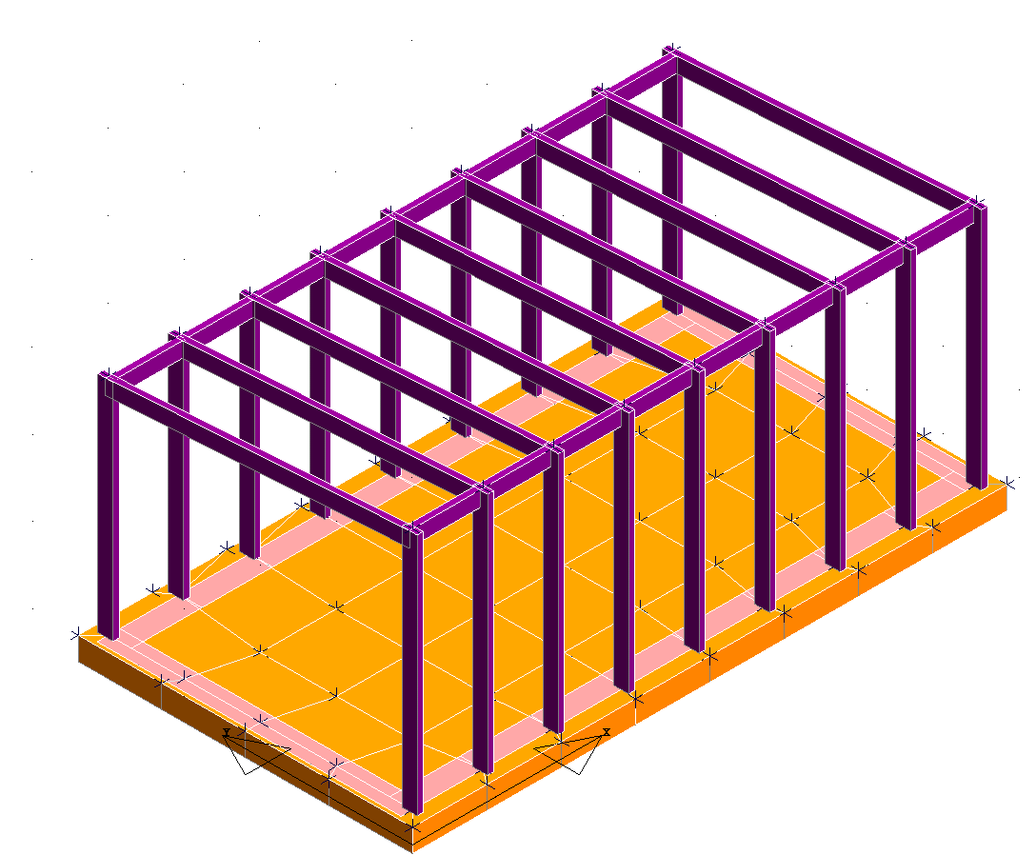
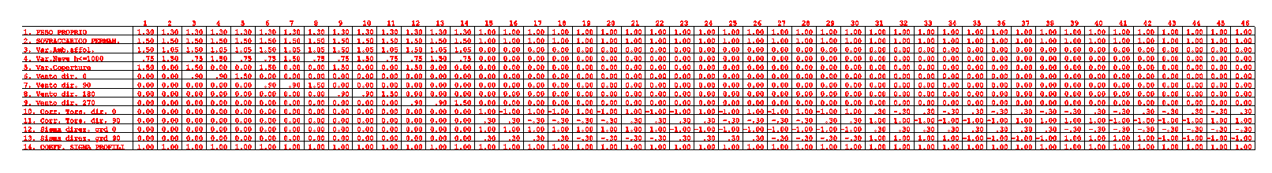
Wooden structures in Italy
Casette – FEM (Finite Element Method)
seismic analysis
Real structure
FEM
combination

Slide 10
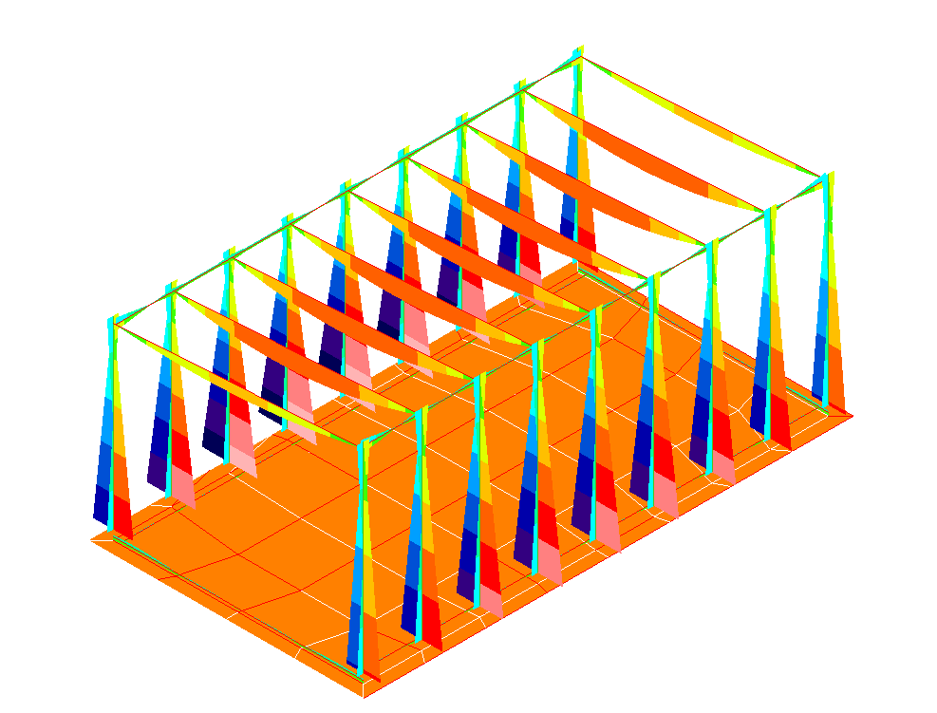
Wooden structures in Italy
Casette – FEM (Finite Element Method)

Slide 11
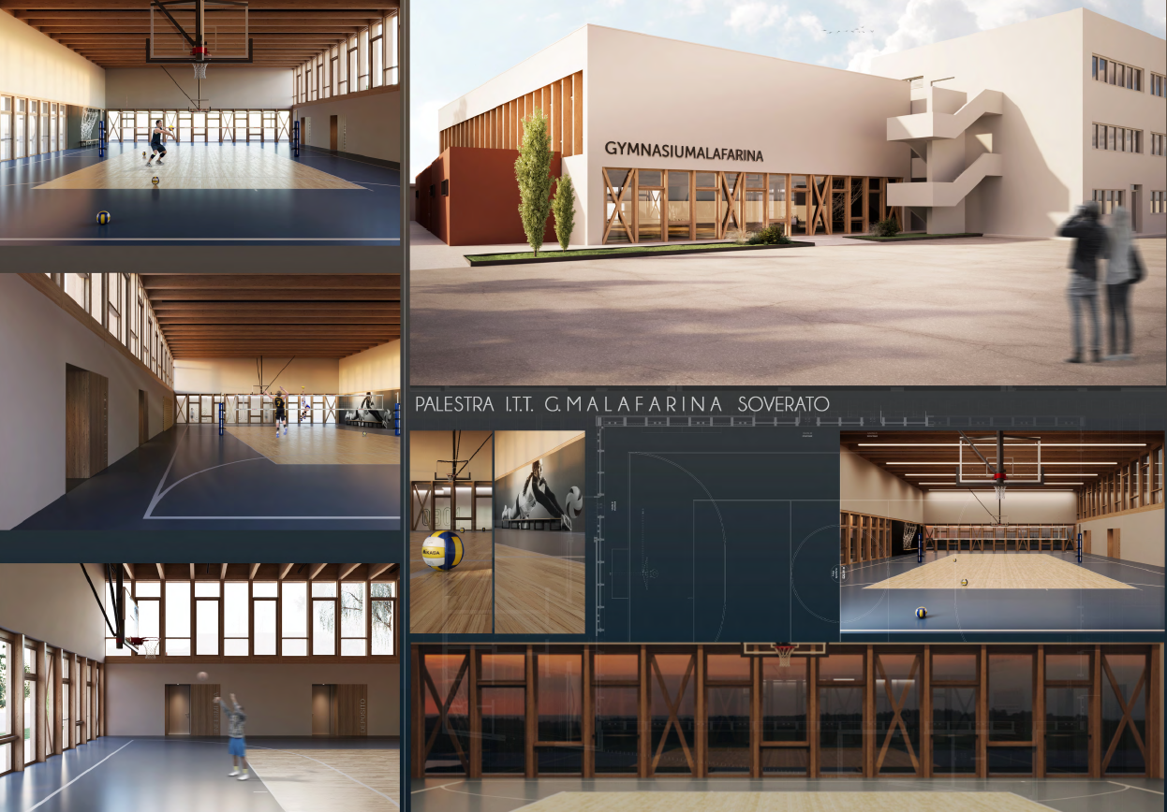
Wooden structures in Italy
New gym under construction at ITT MALAFARINA SOVERATO.
Architectural project

Slide 12
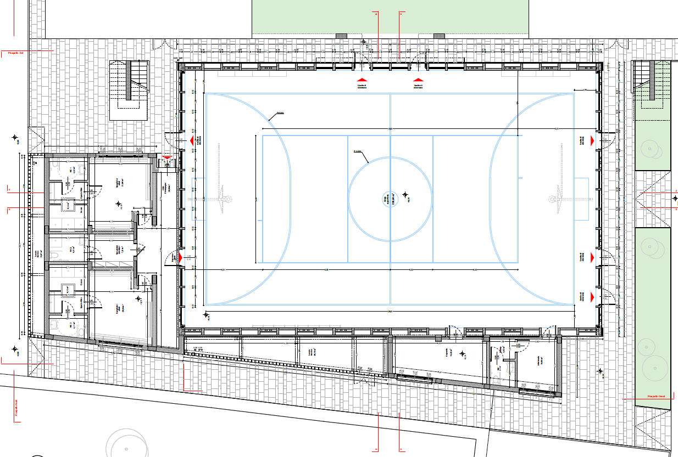
Wooden structures in Italy
New gym under construction at ITT MALAFARINA SOVERATO
Planimetric drawing

Slide 13
Wooden structures in Italy
Why is the use of wood reduced in Italy?
  Building has a long tradition of masonry and reinforced concrete construction, and this culture is still very deep-rooted.
  Costs: although construction times are faster, the initial cost of wooden structures can be higher than traditional construction
  Perception and prejudices: there are still some prejudices against wooden buildings, such as the presumed lower durability or fire resistance.
  Availability of materials and skills: even if the wood supply chain is developing in Italy,
  Climate: Italy is characterized by different climates, some areas with high humidity or strong temperature variations may require particular design and construction measures to guarantee the durability of wooden structures.

Slide 14
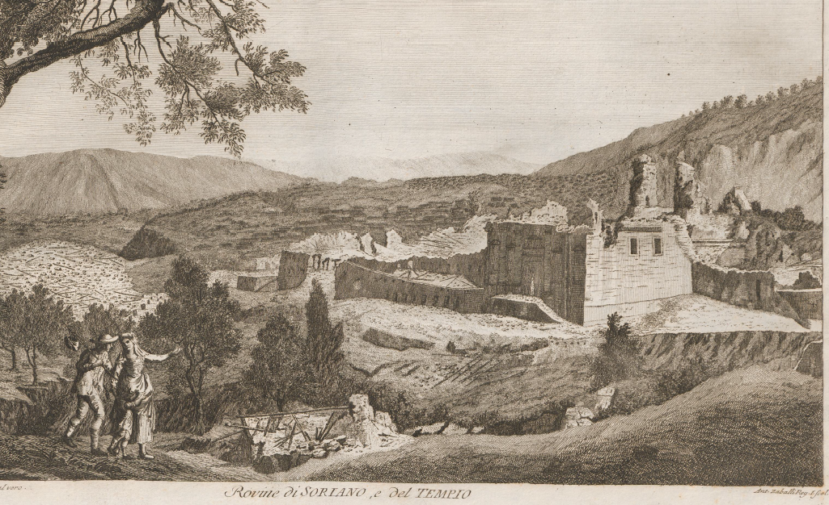
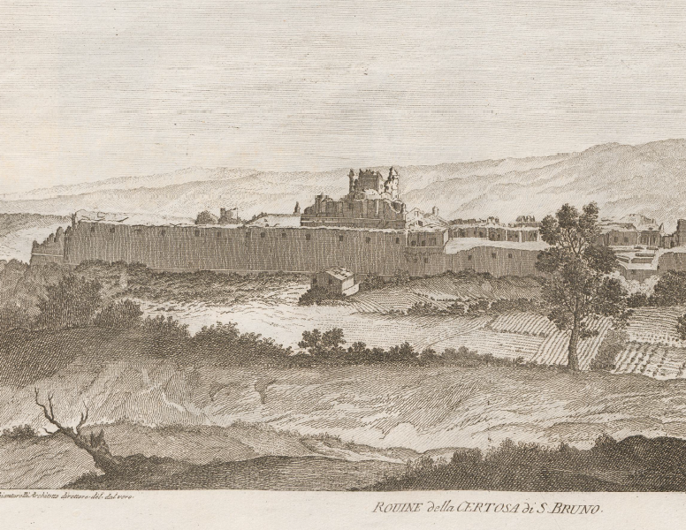
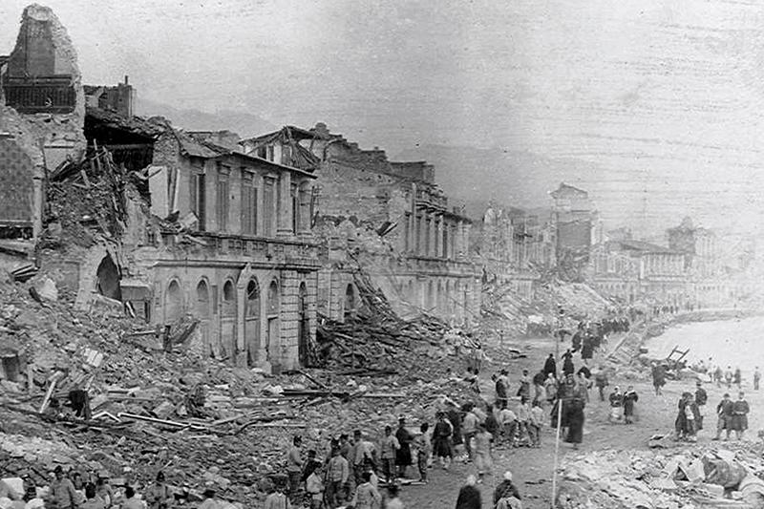
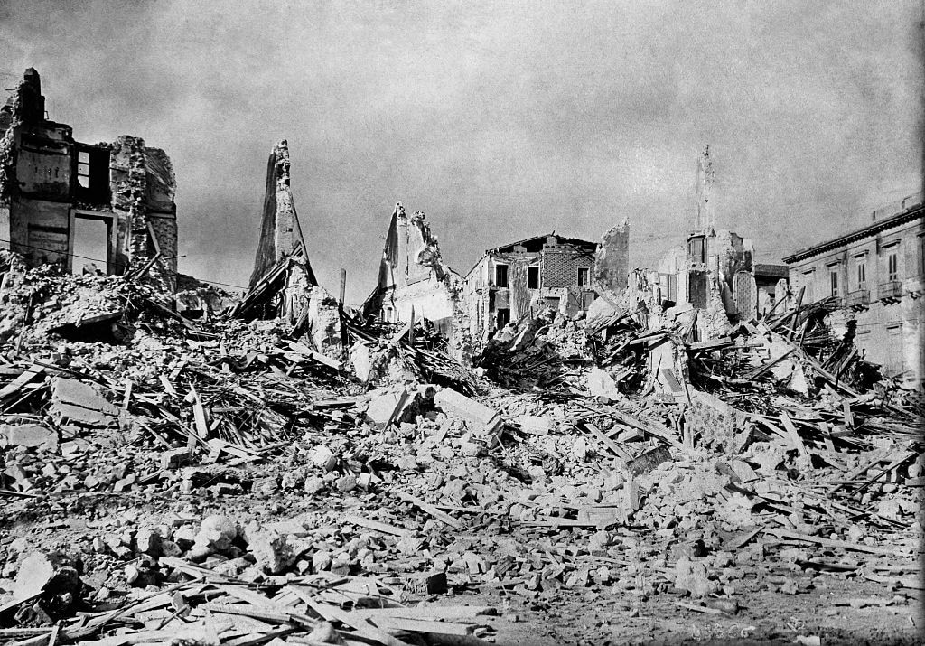
Seismic effects in Italy
1650
1783
Victims
30.000 and 50.000
1908
Victims
75.000 and 80.000
About 120 years

Slide 15
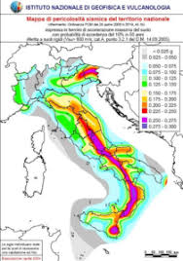
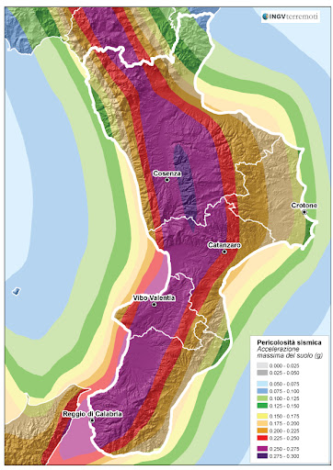
Seismic effects in Italy - the future?
It is important to build with wood

Slide 16
Chemical protection of wood
DEGRADATION FACTORS Atmospheric agents are the elements that cause the greatest degradation of wood light through the photolytic action of ultraviolet and light (UV rays), both high and low temperatures
Ultraviolet radiation is also responsible for the color variation of transparent paint films which tend to take on more yellowish colors and lose part of their transparency.

Slide 17
Chemical protection of wood 2
PROTECTION of wood
Chemical protection can undoubtedly increase its lifespan, . It is therefore a question of applying paint products to the wood that have the following characteristics:
• ability to prevent the development of xylophagous fungi and repel insect attacks;
• ability to resist the degrading action of ultraviolet rays;
• low coefficient of thermal expansion and therefore poor expansion following heating, to be consistent with the behavior of the wood to which they are anchored;
• good degree of impermeability to rainwater, to prevent its penetration into the wood;
• good degree of permeability to water vapor, to allow the wood to lose excess humidity compared to
• ease of maintenance, since the deterioration action of external agents also affects the films of paint products,

Slide 18
Chemical protection of wood 3
CHEMICALS can be thick or water-based. Water-based paints have been an objective pursued by the paint products industry for many years for less pollution,
Water-based paints are composed of aqueous dispersions of resins that form a dry and resistant film through a physical process that involves:
  1_ evaporation of water
  2_ coalescence of the resin in dispersion with consequent formation of a continuous film.
Advantages of water-based paints
hygiene and safety of the working environment
  low odor
  reduced gaseous emissions
  does not pose a fire risk
  greater resistance to UV
  ease of maintenance
  greater elasticity
  does not cause removal problems when over applied • does not yellow
  does not cause self-ignition problems

Slide 19

Thanks for your attention

